Slide 1
Chapter 4
Curve Plotting with MATLAB
MATLAB provides some very powerful features for plotting and labeling curves. These operations can be performed as part of an overall mathematical analysis, or experimental data may be provided to the program for the primary purpose of plotting. Curves obtained from MATLAB plots can be exported to other programs for presentation purposes.

Slide 2
MATLAB has the capability to generate plots of many types. This includes linear plots, line plots, logarithmic plots on both scales, logarithmic plots on one scale, stem plots, bar graphs, and three-dimensional plots. We will be using these capabilities throughout the text, so the present development is intended as an introduction, with many operations to follow in later chapters.

Slide 3
Vector Lengths
A very important fact that should be emphasized at the outset is that to plot one vector against another, the vectors must have the same number of elements. One can plot either a column vector or a row vector versus either a column vector or a row vector provided they have the same number of values.

Slide 4
Different Vector Lengths
If the vectors have different lengths, it is possible to use a portion of the longer one as one of the variables. For example, suppose y has 200 values and x has 120 values. One could define y1 by the following command:
>> y1 = y(1:120)
The variable y1 now has the same number of points as x and the two could be plotted together.

Slide 5
The Variables x and y
In the two-dimensional plotting commands, the horizontal axis will be referred to as the x-axis and the vertical axis will be referred to as the y-axis. However, the actual variables can be labeled with any quantities. It is only in the plot commands that x and y are used.

Slide 6
Creating a Linear Array
Whenever a plot is to be created from an equation, and linear plots for both the dependent and independent variables are desired, the most convenient way to achieve the result is to create a linear array or vector for the values of the independent variable. MATLAB offers a number of different commands that can be used for this purpose. For this explanation, assume that the independent variable is x.

Slide 7
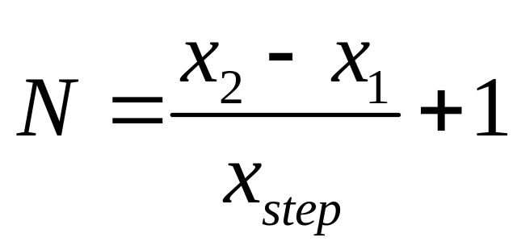
Command for Linear Array
>> x = x1:xstep:x2
where x1=beginning point, x2=final point, and xstep=step size. Assuming that the final point coincides with an integer multiple of xstep, the number of points N is

Slide 8
Alternate Command for Linear Array
>> x = linspace(x1, x2, N)
where x1=beginning point, x2=final point, and N=number of points. The name linspace represents “linear spacing”. Again, the number of points N is

Slide 9
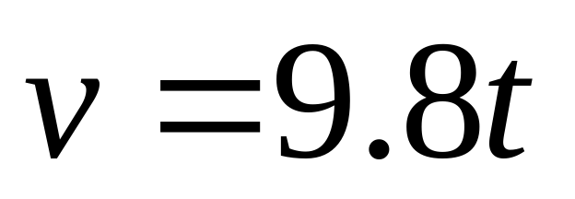
Example 4-1. When air resistance can be ignored, the velocity (in m/s) of an object falling from rest is
Use MATLAB to plot the velocity over a time interval from 0 to 10 s.

Slide 10
Example 4-1. Continuation.
It should be emphasized that this is a simple linear equation with a vertical intercept of 0 so we actually need only two points to plot the curve. However, our purpose is to learn how to use MATLAB for plotting and we will utilize far more points than necessary as a learning process.

Slide 11
Example 4-1. Continuation.
A time step of 0.1 s will be selected.
>> t = 0:0.1:10;
Alternately,
>> t = linspace(0,10,101);

Slide 12
Example 4-1. Continuation. We can inspect various values of t.
>> t(1:5)
ans =
0 0.1000 0.2000 0.3000 0.4000

Slide 13
Example 4-1. Continuation.
>> v = 9.8*t;
This command generates 101 values of v corresponding to the 101 values of t. It can be plotted by the command
>> plot(t, v)
The result is a “raw” plot but various labels can be added as will be shown on the next slide.

Slide 14
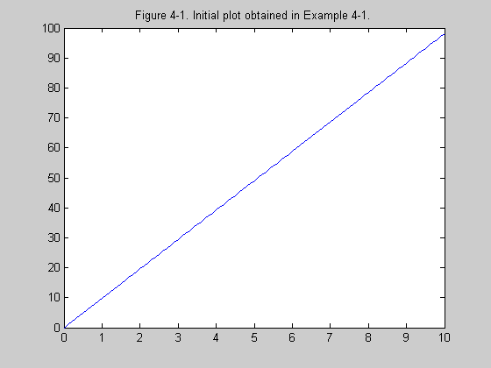

Slide 15
Example 4-1. Continuation.
A horizontal label is provided.
>> xlabel(‘Time, seconds’)
A vertical label is provided.
>> ylabel(‘Velocity, meters/second’)
A title is provided.
>> title(‘Figure 4-3. Velocity of falling object of Example 4-1 with grid.’)
A grid is added.
>> grid

Slide 16
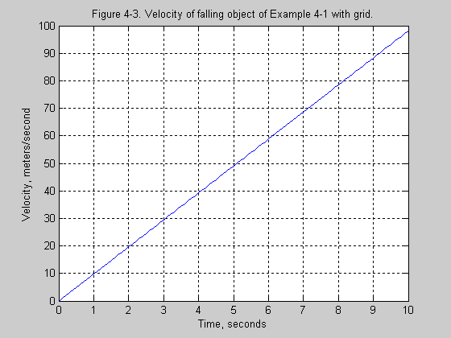

Slide 17
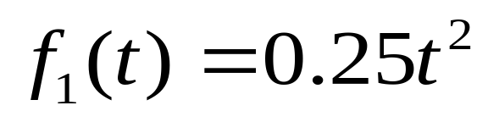
Example 4-2. A force in newtons (N) is given below. Plot the function.
Assume 101-point t vector is in memory.
>> f1 = 0.25*t.*t; or
>> f1 = 0.25*t.^2:
>> plot(t, f1)
>> xlabel(‘Time, seconds’)
>> ylabel(‘Force, newtons’)
>> title(‘Figure 4-4. Force as a function of time in Example 4-2.’)
>> grid

Slide 18
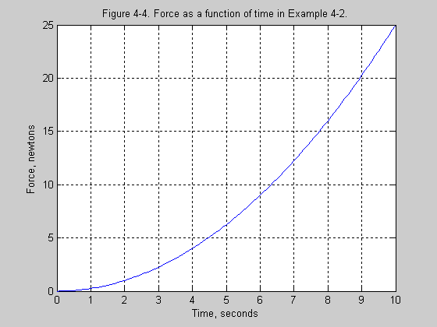

Slide 19
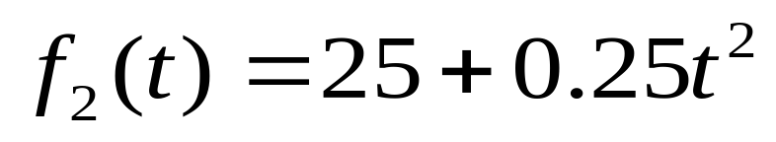
Example 4-3. A force in newtons (N) is given below. Plot the function.
Assume 101-point t-vector is in memory.
>> f2 = 25+0.25*t.^2;
>> plot(t, f2)
>> xlabel(‘Time, seconds’)
>> ylabel(‘Force, newtons’)
>> title(‘Figure 4-6. Second force as initially obtained in Example 4-3.’)
>> grid

Slide 20
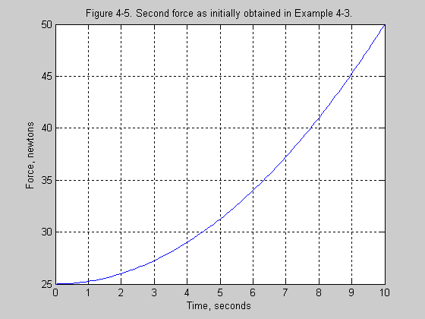

Slide 21
Example 4-3. Continuation.
Plot is modified by the command
>> axis([0 10 0 50])

Slide 22
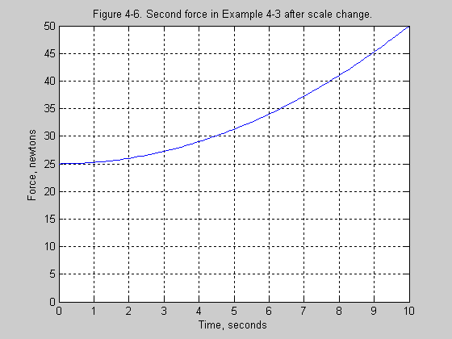

Slide 23
Multiple Plots on Same Graph
The two functions f₁ and f₂ of the previous two examples can be plotted on the same graph by the command
>> plot(t, f1, t, f2)
The command gtext(‘label’) allows a label to placed on a graph using crosshairs. The resulting functions are shown on the next slide.

Slide 24
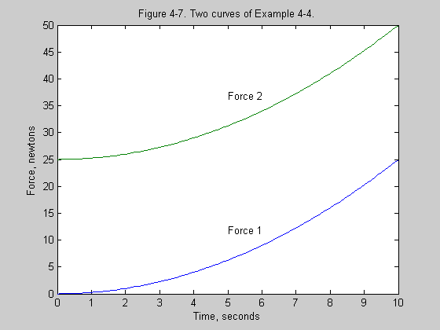

Slide 25
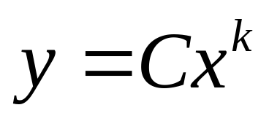
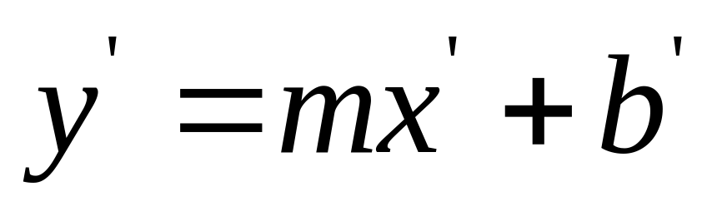
Log-Log Plots

Slide 26
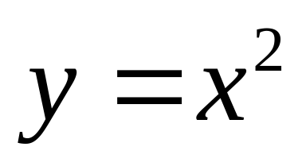
Example 4-5. Plot the 2nd degree function below on a log-log graph.
>> x = logspace(-1, 1, 100);
>> y = x.^2;
>> loglog(x, y)
A grid and additional labeling were provided and the curve is shown on the next slide.

Slide 27
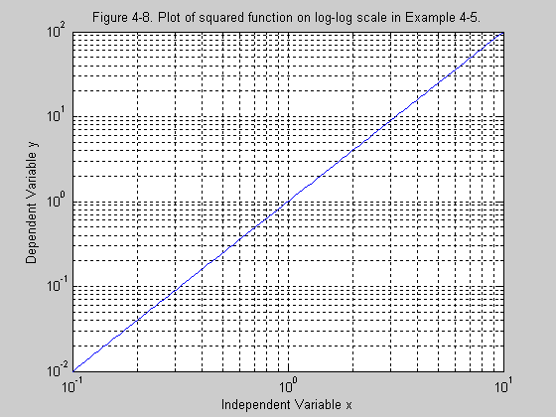

Slide 28
Bar and Stem Plots
Command for a bar plot:
>> bar (x, y)
Command for a stem plot:
>> stem (x, y)

Slide 29
Example 4-6. The text contains the sales in thousands of dollars for a small business from 1993 through 2002. Construct a bar graph.
>> year = 1993:2002;
>> sales = [ the 10 values in the text];
>> bar(year, sales)
The graph with additional labeling is shown on the next slide.

Slide 30
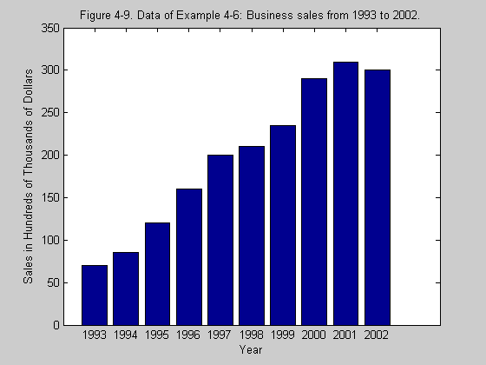

Slide 31
Example 4-7. Plot the data of the previous example using a stem plot.
Assume that the variables year and sales are still in memory. The command is
>> stem (year, sales)
The plot with additional labeling is shown on the next slide.

Slide 32
